Slide 1
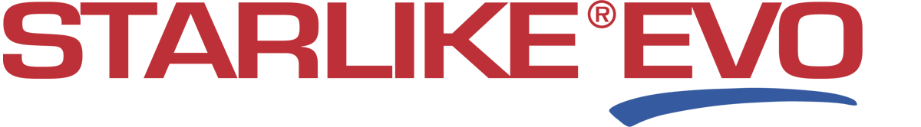
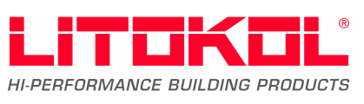
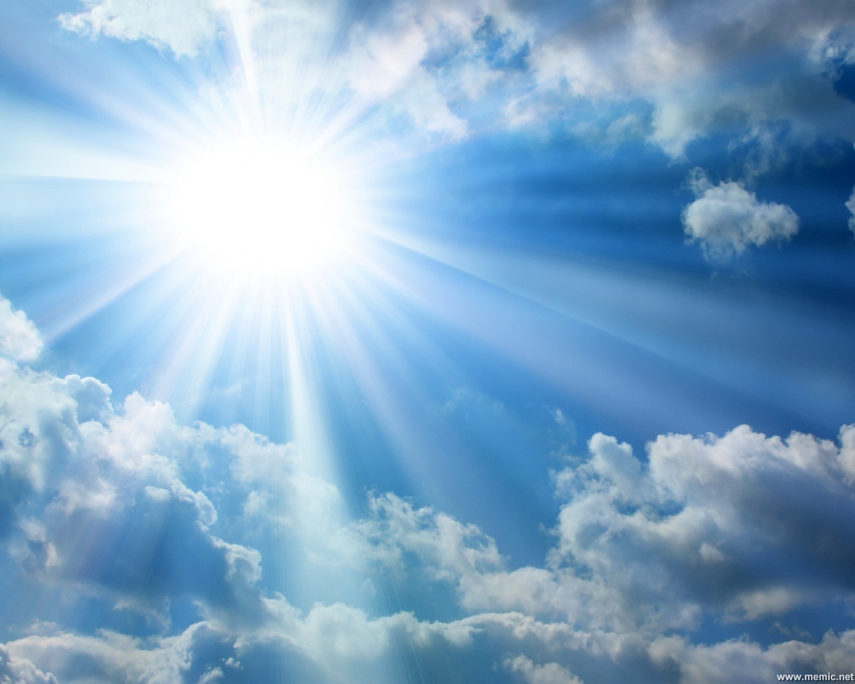
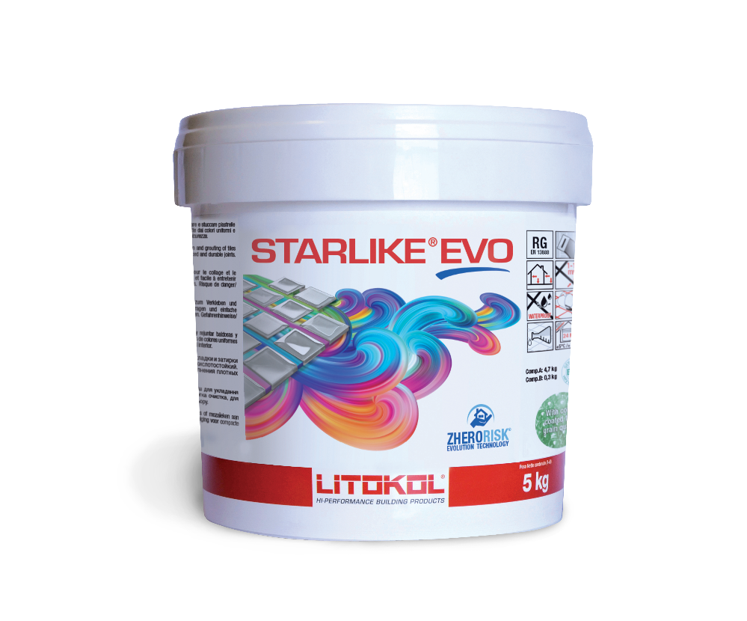
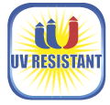
Resists to the yellowing caused by uv rays
C
The tests state that the new formula of Starlike EVO has reached the maximum values of resistance to yellowing processes and ageing caused by UV rays combined with meteorological-climate action.
It guaratees the functional and aesthetical stability over time even under extreme climate conditions.
For this purpose Starlike EVO can
be declared “UV RESISTANT”.
© Litokol 2011. All rights reserved.
< >
HOME

Slide 2
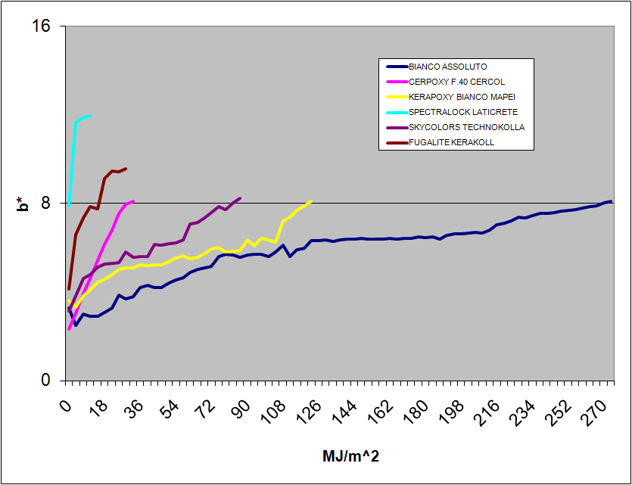
Resists to the yellowing caused by uv rays
Yellowing trend
Starlike EVO Bianco assoluto
STARLIKE EVO BIANCO ASSOLUTO
LITOKOL
COMPETITORS
© Litokol 2011. All rights reserved.
< >
HOME

Slide 3
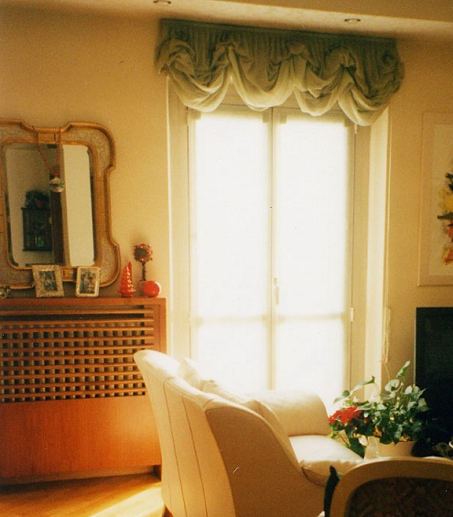
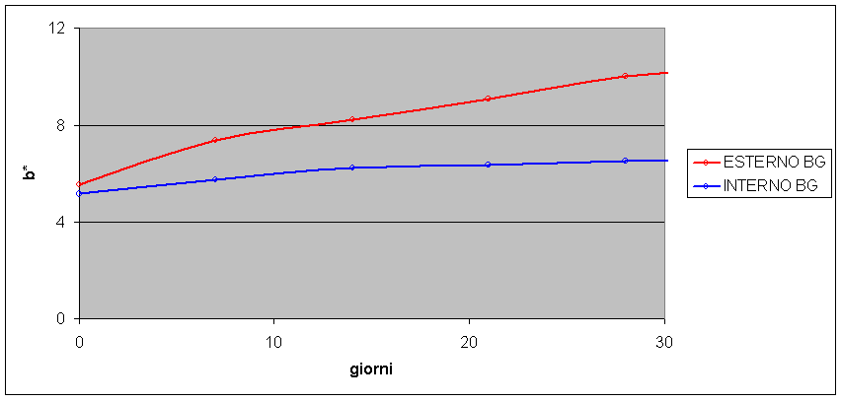
Resists to the yellowing caused by uv rays
The yellowing resistance duration in interior environments (long periods of shadow, spaced out by the presence of light filtered by glass-window) is from 6 up to 10 times higher than outdoor areas.
Yellowing resistance
Outdoor = 402 days
Indoor = 10-11 years
© Litokol 2011. All rights reserved.
< >
HOME

Slide 4
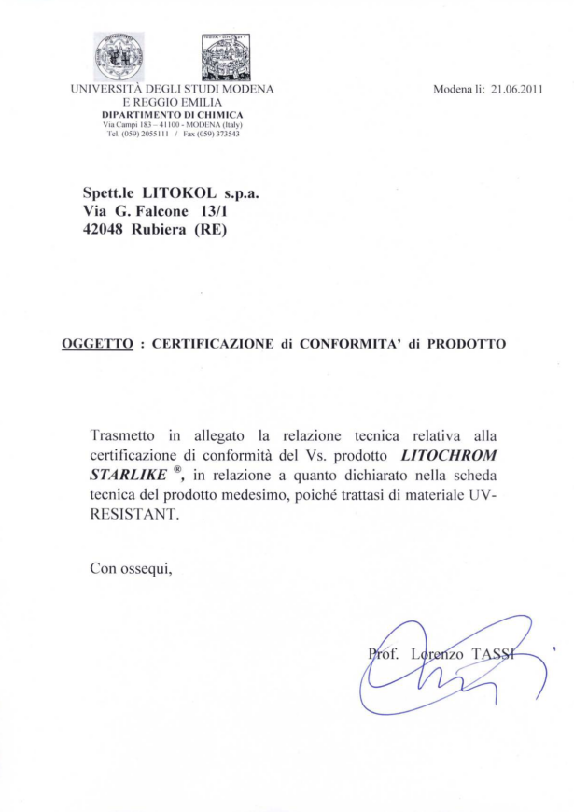

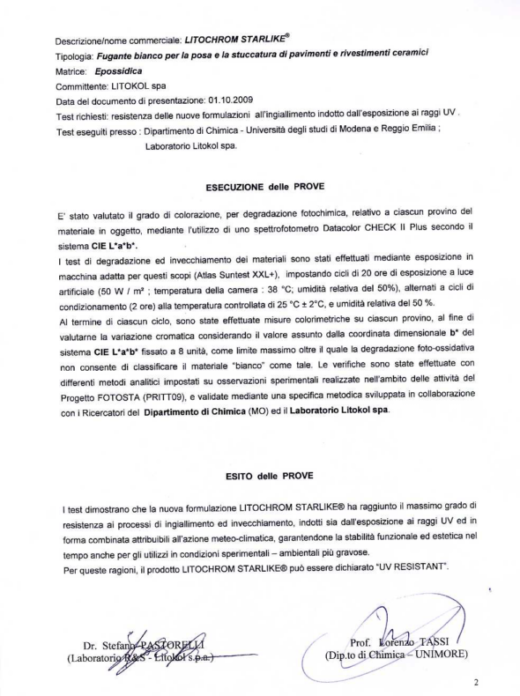
Certification
“
The tests confirm that Starlike EVO new formulation has achieved the maximum resistance to yellowing and ageing processes caused by both UV rays exposition and meteorological-climate combined action, guaranteeing the functioning and aesthetical stability in the time for the severest experimental-environmental using. For these reasons Starlike EVO is declared
“UV RESISTANT”.
“
© Litokol 2011. All rights reserved.

Slide 5

Patents
The validity of these results has been confirmed by the University of Modena and Reggio Emilia releasing Starlike EVO UV–resistance performances conformity certificate.
As a matter of fact, the tests carried out concerning the new formulations UV rays resistance, has ascertained to be ameliorative, enabling, thus, to take out a further patent.
Moreover, the value of an exclusive research in the grouting mortars market, has proved, to be beyond market nowadays knowledge limits.
Starlike EVO is the unique epoxy mortar patented as UV-resistant on the market. Furthermore, is the only one having the UV-RESISTANT conformity certificate released by an university institution.
Patented
© Litokol 2011. All rights reserved.
HOME
< >

Slide 6
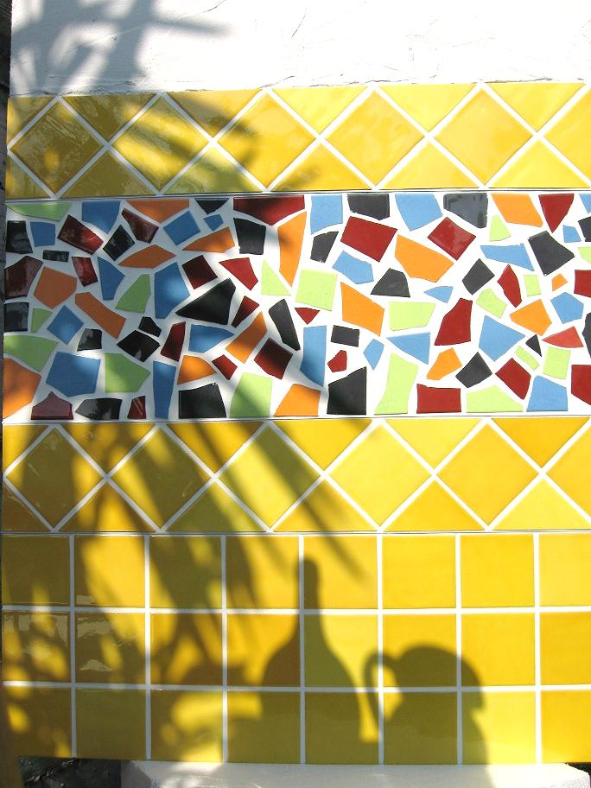
Absolute White
The Bianco Assoluto White replaces the Snow White
Technical specifications:
● New UV-Resistant formula
● Extra-fine granulometry
Aesthetic Features
● Extremely pure and bright white colour
● The surface finish is particularly smooth and shiny
● It is possible to seal both joints 15mm wide and “touching effect” joints.
● It is ideal for outdoor installation, because preserves the joints from the progressive yellowing, caused by sun exposure together with weather and climate factors.
© Litokol 2011. All rights reserved.
HOME
< >

Slide 7
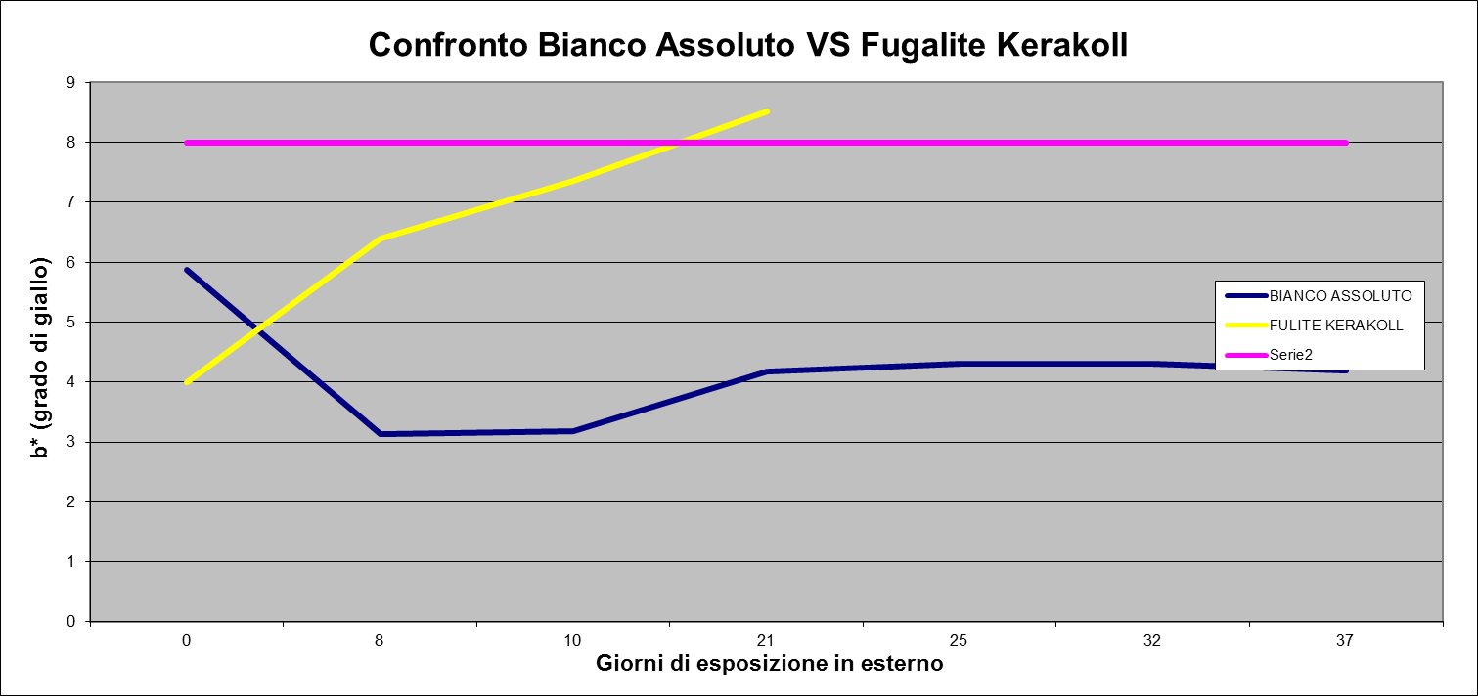


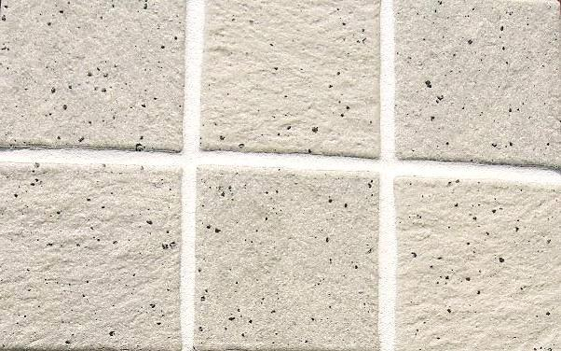
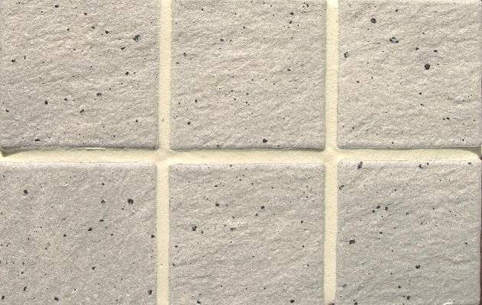
Bianco Assoluto
Bianco Assolouto vs competitors
COMPETITORS
Starlike EVO Bianco Assoluto white Competitors
© Litokol 2011. All rights reserved.
< >
HOME

